Slide 1
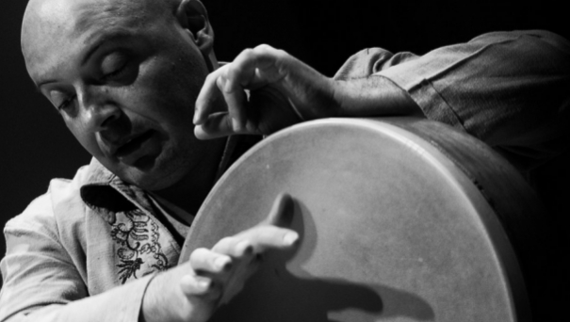
COMPANION SLIDES
MYP4 MUSIC: MUSICAL EXPRESSION IS A UNIVERSAL FEATURE OF HUMAN EXPERIENCE
Notes:
These slides are for use with the Teacher Guide for the MYP4 Music unit: Musical Expression is a Universal Feature of Human Experience. Please read the Teacher Guide before using the slides.

Slide 2
LESSON 4.1-4.2: INTRODUCING THE UNIT OF INQUIRY

Slide 3
FACTUAL | What is ethnomusicology? (Boundaries) What is tradition-based music? (Audience/Boundaries)
CONCEPTUAL | Why may the preservation of tradition-based music heritage be a shared responsibility for all of us? (Audiences/boundaries) Why is music sometimes referred to as an international language? (Audience/boundaries)
DEBATABLE | To what extent can tradition-based music transcend cultural difference? (Audiences/boundaries) To what extent can tradition-based music be hybridised without losing the artistic energy that makes it powerful? (Audiences/boundaries/innovation)

Slide 4
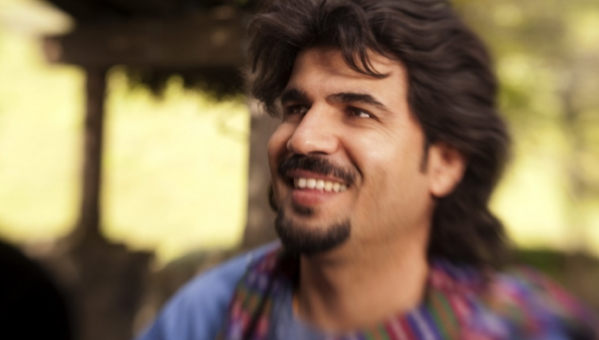
Homayoun Sakhi Photographer Jay Blakesberg

Slide 5
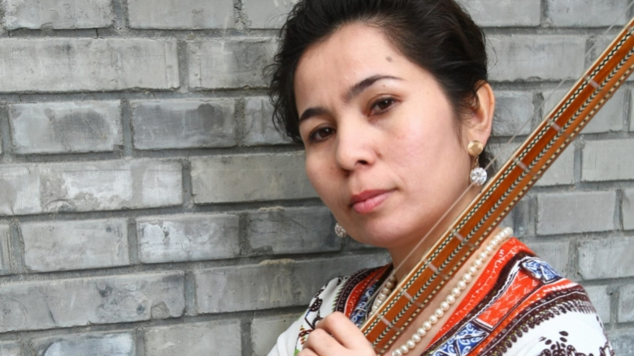
Sanubar Tursun Photographer Feng Li

Slide 6
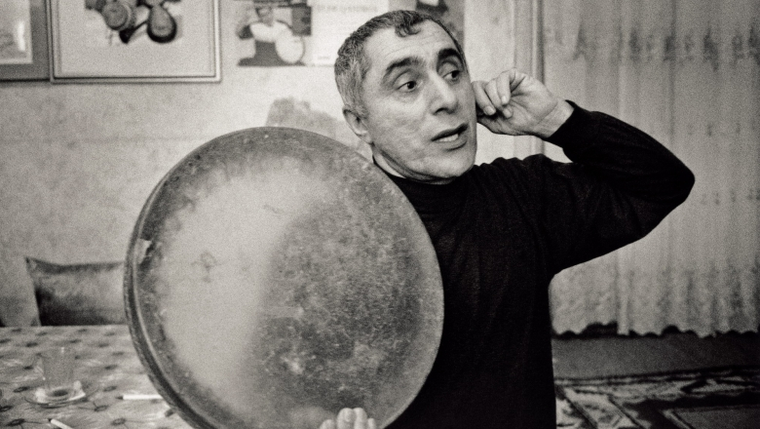
Alim Qasimov Photographer Sebastian Schutyser/AKMP

Slide 7
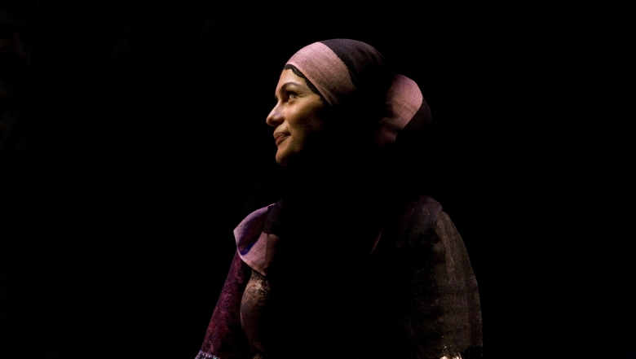
Fargana Qasimova Photographer Sebastian Schutyser/AKMP

Slide 8
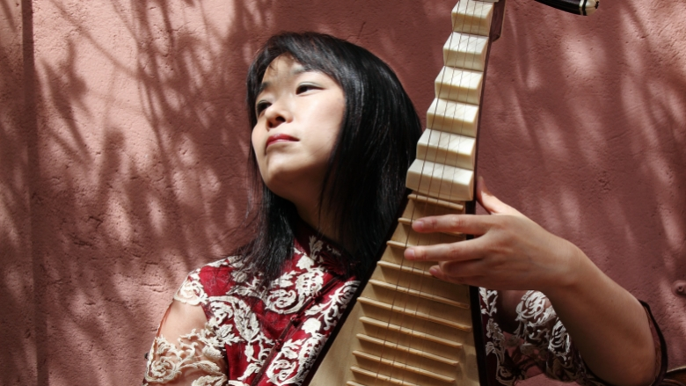
Wu Man Photographer Sebastian Schutyser/AKMP

Slide 9
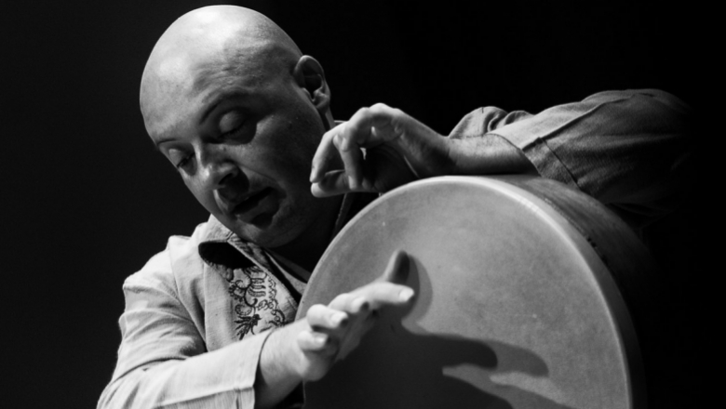
Andrea Piccioni Photographer Lauren Pasche

Slide 10
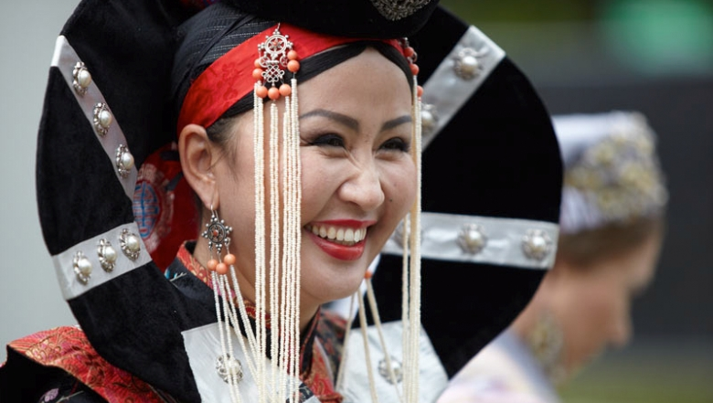
Byambajargal Gombodorj Photographer AKDN

Slide 11
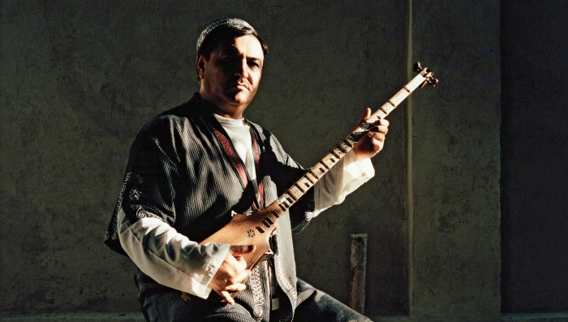
Abdulalavi Abdurashidov Photographer Sebastian Schutyser/AKMP

Slide 12
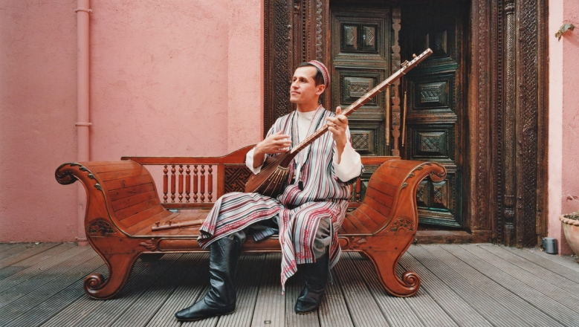
Sirojiddin Juraev Photographer Sebastian Schutyser/AKMP

Slide 13
Kronos Quartet Photographer Jay Blakesberg

Slide 14
LESSON 4.3: THE POWER OF MUSIC

Slide 15
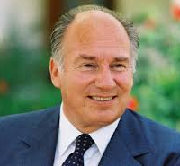
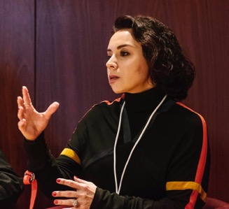
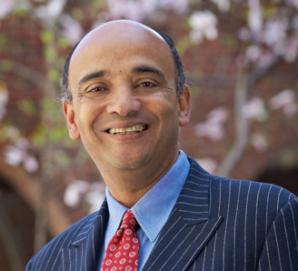
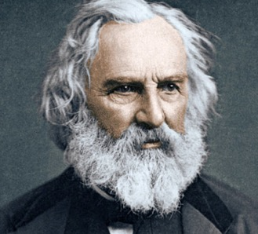
‘Every individual can respond to art and music whether it emanates from a different culture or not. For after all, art is a matter of humanity just as much as it is a matter of identity.’
His Highness the Aga Khan
‘Music can strengthen a sense of community by imbuing its members with a collective sense of their own shared history and identity.’
Fairouz Nishanova, Director of the Aga Khan Music Programme
‘One connection — the one neglected in talk of cultural patrimony — is the connection not through identity but despite difference.’
Kwame Anthony Appiah, Philosopher, Cultural theorist, Novelist
‘Music is the universal language of mankind.’
Henry Wadsworth Longfellow, Poet
Images: His Highness the Aga Khan, AKDN | Fairouz Nishanova. Photographer AKTC/AKDN | Kwame Anthony Appiah, Smith.edu | Henry Wadsworth Longfellow, poet
Notes:
Cultural Patrimony: artefacts possessing continuing cultural, traditional or historical importance to the heritage of a group of people
Sources:
His Highness, the Aga Khan. 2019. Remarks at the inaugural Aga Khan Music Awards.
Kimmelman, Michael. 2010. Who Draws the Borders of Culture? New York Times.
The Ismail. 2019. In Conversation. An Interview Series.

Slide 16
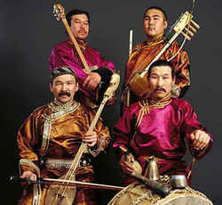
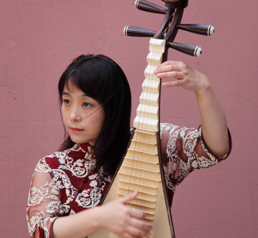
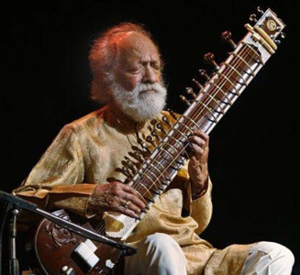
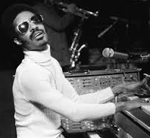
‘Unlike most music which is created with the expectation that it will be heard by human ears, throat singing traditionally had no audience. Rather, it was directed toward the spirit world, as an offering.’
Theodore Levin, Dartmouth College
Image of Huun-Hur Tu
‘The tonality and the musical language, the vocabulary [of the piece] right now is ... very much Chinese.’
Wu Man, Pipa Virtuoso
and Composer, discussing her own work
‘The highest aim of our music is to reveal the essence of the universe it reflects, and the Ragas are among the means by which this essence can be apprehended. Thus, through music, one can reach God.’
Ravi Shankar, Sitar Maestro
‘Music is a world within itself
With a language we all understand
With an equal opportunity
For all to sing, dance and clap their hands.’
Stevie Wonder, Musician and Composer, from his song, Sir Duke
Images: Huun-Hur Tu: Dicogs | Wu Man: AKDN | Ravi Shankar: NPR | Stevie Wonder: Rolling Stone

Slide 17
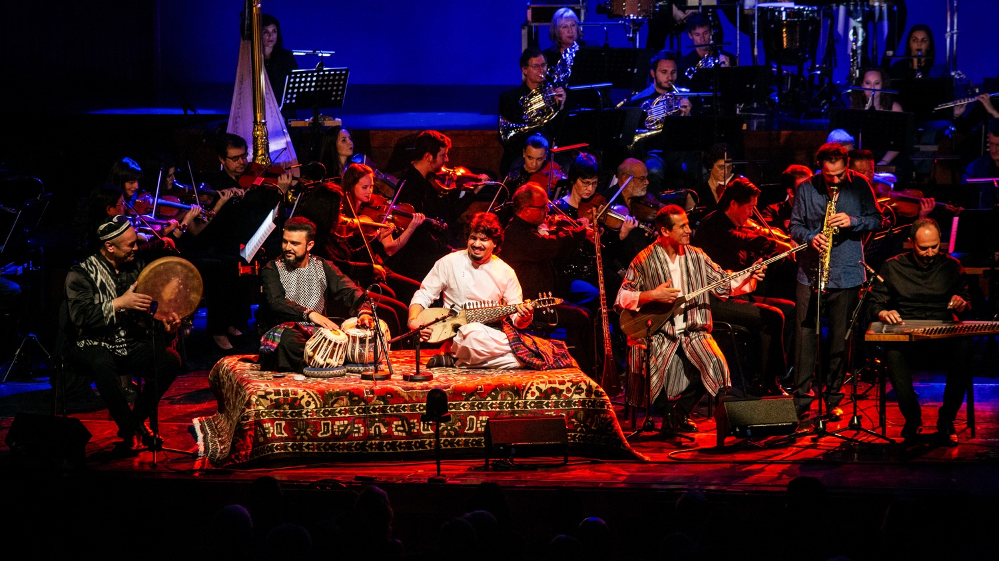
The Aga Khan Master Musicians at the Aga Khan Music Awards in Lisbon in 2019. Photographer Jose Fernandes/AKDN
4.17
Notes:
Caption: The Aga Khan Master Musicians at the Aga Khan Music Awards in Lisbon in 2019. Photographer Jose Fernandes/AKDN

Slide 18
LESSON 4.6: LISTENING & RESPONDING TO URTYN DUU

Slide 19
Byambajargal Gombodorj Photographer AKDN

Slide 20
LESSON 4.7: LISTENING & RESPONDING TO A TRADITION-BASED STRING COLLABORATION

Slide 21
Wu Man Photographer Sebastian Schutyser/AKMP

Slide 22
Sirojiddin Juraev Photographer Sebastian Schutyser/AKMP

Slide 23
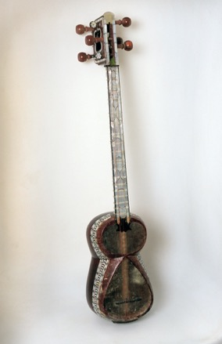
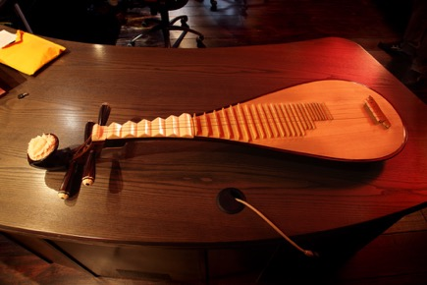
Pipa
Short-necked plucked lute that came to China from Central Asia around the 7th century. It has 4 metal strings and 6 wedge-shaped frets, as well as 26 smaller bamboo frets.
Sato
Bowed tanbur, or long-necked lute, now rare, played by performers of Tajik-Uzbek classical music.
Dutar
Designates different kinds of two-stringed long-necked fretted lutes among Uzbeks, Tajiks, Turkmens, Qaraqalpaqs, Uyghurs, and other groups.
Photographer Schutyser/AKMP Source: akdn.org/akmpSebastian/instruments

Slide 24
LESSON 4.8: LISTENING & RESPONDING TO MUSIC WHERE EASTERN AND WESTERN TRADITIONS MERGE

Slide 25
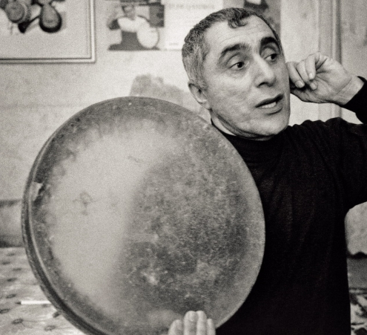
Alim Qasimov Photographer Sebastian Schutyser/AKMP
Daf
A small frame drum with jingles used to accompany both popular and classical music in Azerbaijan.
Source: akdn.org/akmp/instruments
Notes:
There is a longer version of the video clip embedded in this slide at https://vimeopro.com/akmp/homayun-sakhi/video/297908095?, if you want to show more of the collaborative work.

Slide 26
Rubab
Fretless lute, always with sympathetic strings, played in southern Tajikistan and Afghanistan.
Photographer Jay Blakesberg Source: akdn.org/akmp/instruments

Slide 27
LESSON 4.9: THE MASTER-APPRENTICE (USTOD-SHOGIRD) TRADITION OF MUSIC EDUCATION

Slide 28
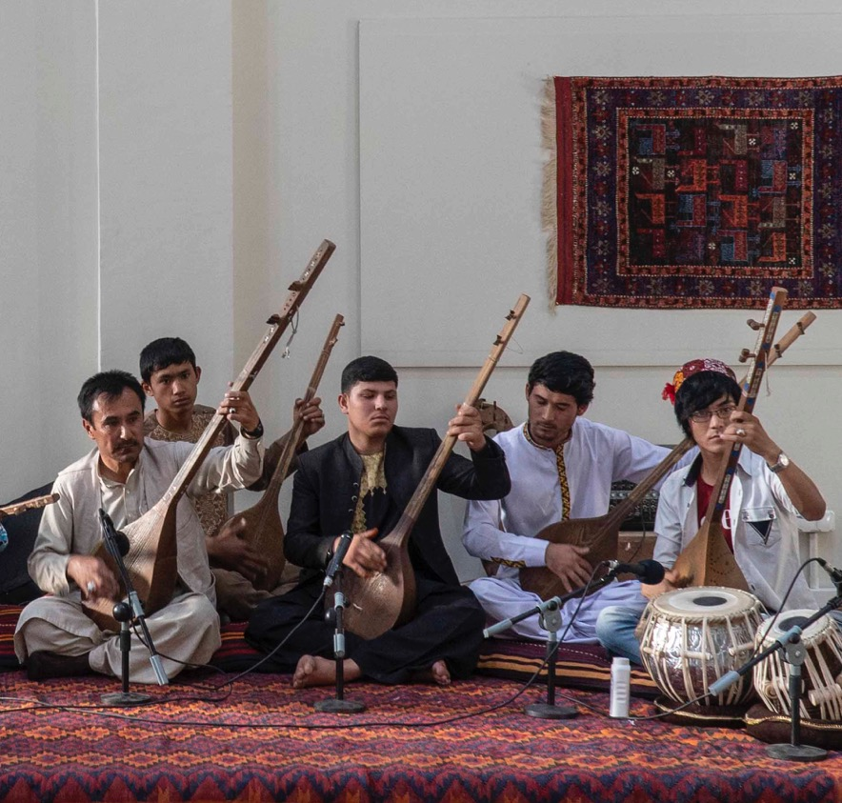
Afghanistan
Master-Apprentice Music Training Programme (Kabul and Herat): Launched in 2003, the Master-Apprentice (ustod-shogird) Music Training Programme has offered training in instrumental and vocal music to more than a thousand students.
Students have studied a variety of local instruments — rubab, tanbur, dutar, tabla, dilruba, and others — as well as singing. Many graduates have gone on to become prominent performers in Afghanistan’s music scene.
Ustod-shogird, Afghanistan. Photographer AKTC/AKDN.

Slide 29
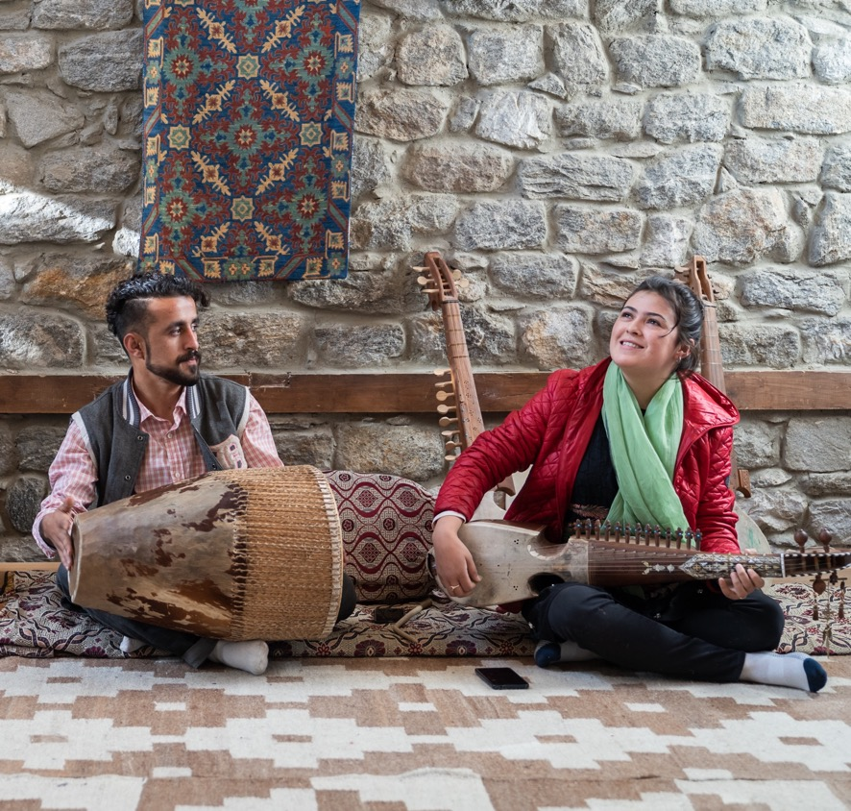
Pakistan
The Leif Larsen Music Centre, Leif Larsen Centre serves the local community by providing free music lessons for young people on a range of musical instruments (rubab, xighini, dadang, damal, flute, and a local version of the sitar) and providing them with performance opportunities both in the Gilgit-Baltistan region and beyond.
Training musicians to fulfil a niche role in the cultural services sector serves a dual purpose, demonstrating that music can be a source of livelihood as well as a living cultural resource and potential source of cultural tourism.
Leif Larsen Music Centre. Altit, Pakistan. Photographer Christopher Wilton-Steer/AKDN

Slide 30
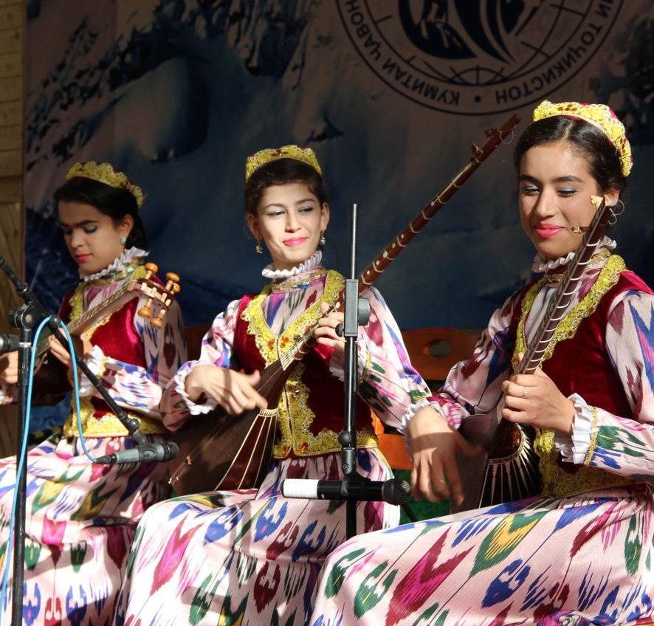
Tajikistan
Khunar Centre is based in Khujand and offers a master-apprentice (ustod-shogird) training programme to children and young adults throughout northern Tajikistan’s Sogd Region as well as in Darvoz (GBAO) and Shakhrinav (Gissar Region).
Students in the training programme study instruments such as dutar, tanbur, tar, ghijak, and doira as well as classical Tajik vocal music. Khunar Centre also operates a musical instrument-building workshop and oversees the Dilnavoz Ensemble, which serves as a laboratory for talented young musicians to create new music inspired but not constrained by tradition.
AKMI artists from Tajikistan and Afghanistan, Roof of the World festival, Khorog, Tajikistan, July 2016. Photographer Kiril Kuzmin/AKMP

Slide 31
Sirojiddin Juraev Photographer Sebastian Schutyser/AKMP

Slide 32
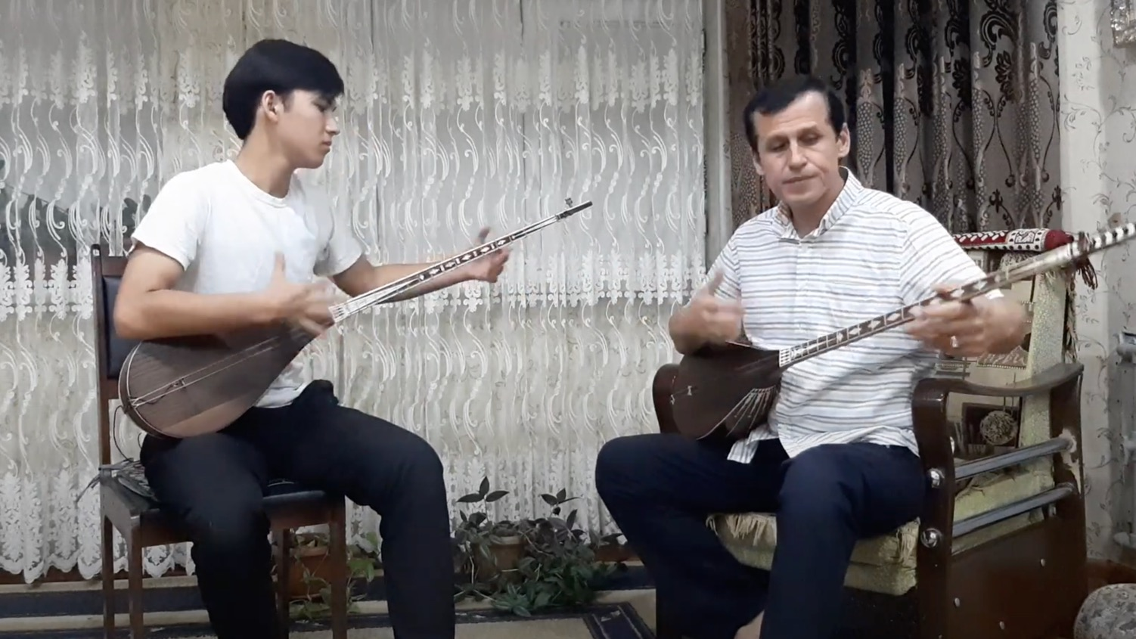
Sirojiddin Juraev teaching his son, Ghiyosiddin

Slide 33
WEEK 7-8: WORKING IN A GROUP TO DEVELOP AND CREATE AN INNOVATIVE HYBRID PERFORMANCE

Slide 34
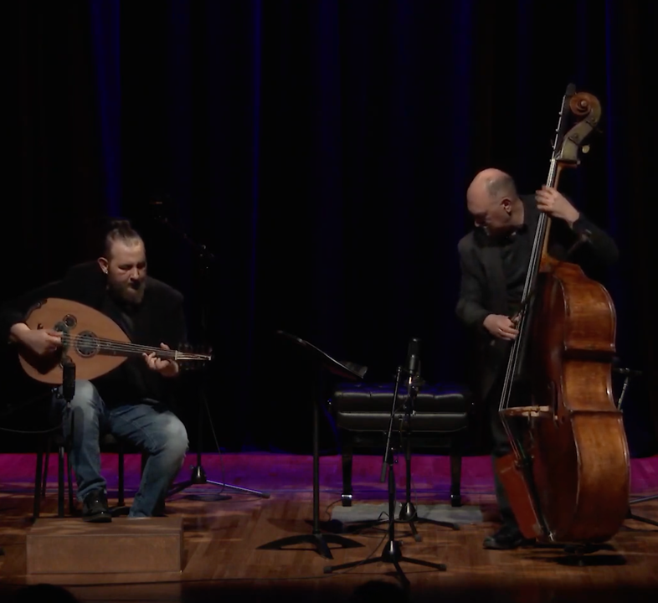
Nazih Borish
Syrian master oud player and Roberto Occhipinti, Canadian bassist, at the Aga Khan Museum, Toronto, May 2019
4.34

Slide 35
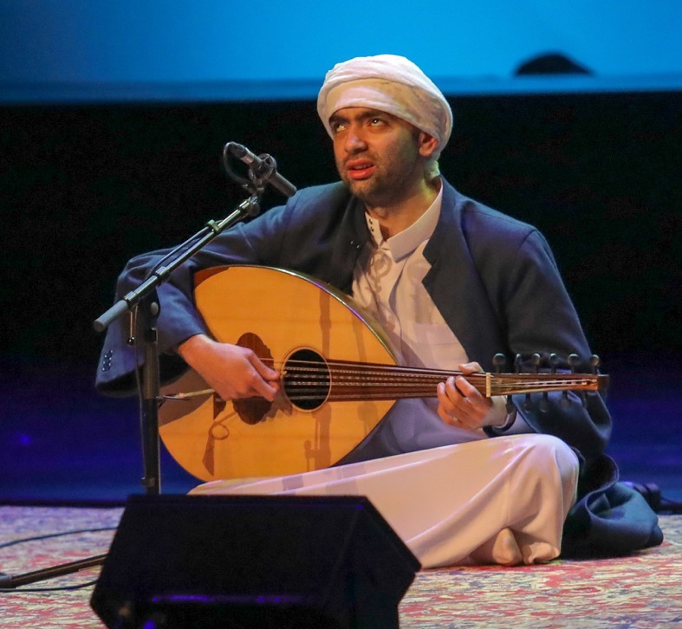
Oud
Pear-shaped stringed instrument commonly used in Persian, Arabic, Greek, Turkish, Jewish, Byzantine, Azerbaijani, Armenian, North African (Chaabi, Classical, and Spanish Andalusian), Somali and Middle Eastern music. Construction of the oud is similar to that of the lute.
Source: akdn.org/akmp/instruments
Egyptian oud player, singer, composer, musicologist, and music teacher Mustafa Said at the Aga Khan Music Awards
2019. Photographer Jose Fernandes/AKDN

Slide 36
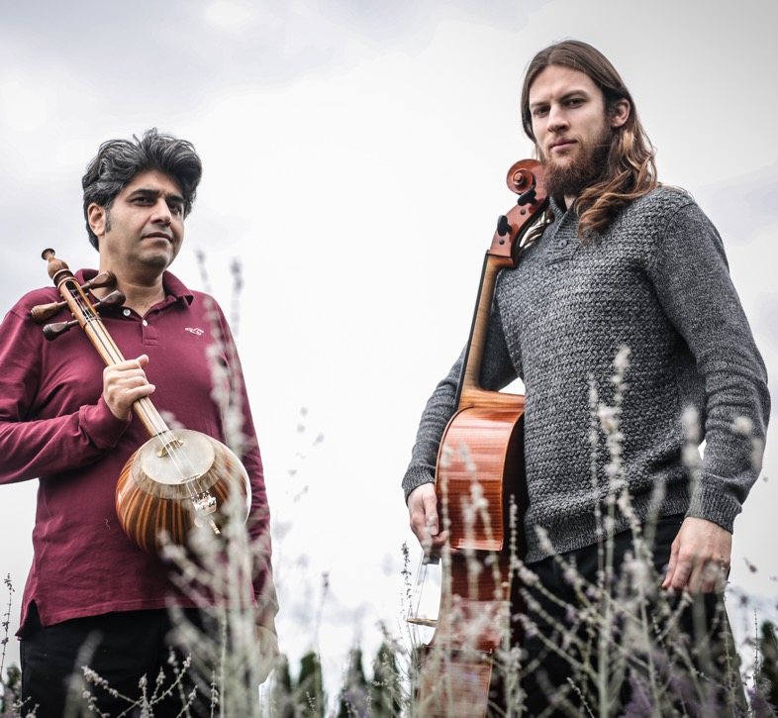
Kamancello
Kamancello, a Canadian duo of Shahriyar Jamshidi who plays the Kurdish kamancha (also, kamanche) and Raphael Weinroth-Browne classical cellist. May 2019
Photographer AKM

Slide 37
Kamancha (also kamanche)
Spherical spike fiddle with a cylindrical neck fitted with four steel strings. The resonating chamber is traditionally covered with catfish skin. To play different strings, performers turn the instrument left or right on its spike rather than change the angle of the bow.
Photographer Sebastian Schutyser/AKMP Source: akdn.org/akmp/instruments

